Slide 1
How do Evil Twin WiFi attacks factor into corporate risk assessments, and what measures can organizations take to address and avoid this threat?
By Aleksandar Garkov

Slide 2
Content
The essence/what is an Evil Twin Wi-Fi Attack
How dangerous is it to organizations?
How can it be prevented?
2

Slide 3

What is an Evil Twin Wi-Fi attack
3

Slide 4
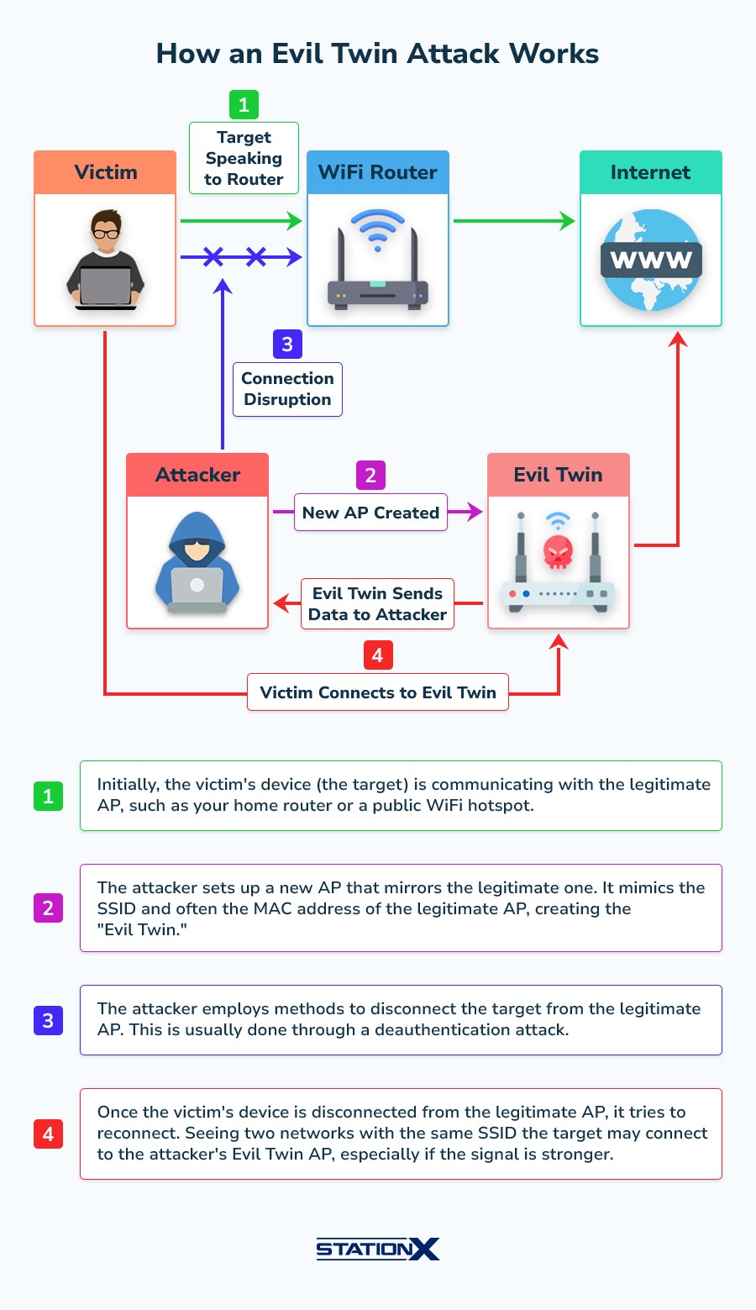
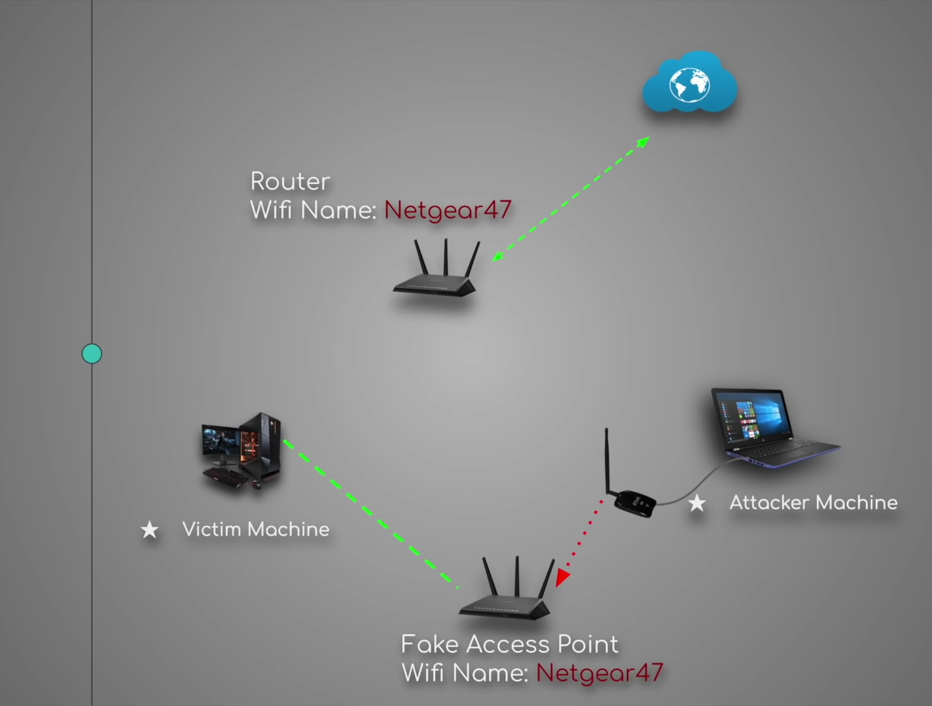
What is an Evil Twin Wi-Fi attack
4

Slide 5

What tools does the attacker need
Dedicated Wi-Fi antenna
Kali Linux integrated tools
Hosted Captive Portal on an Apache server
Running Database to store info
5

Slide 6
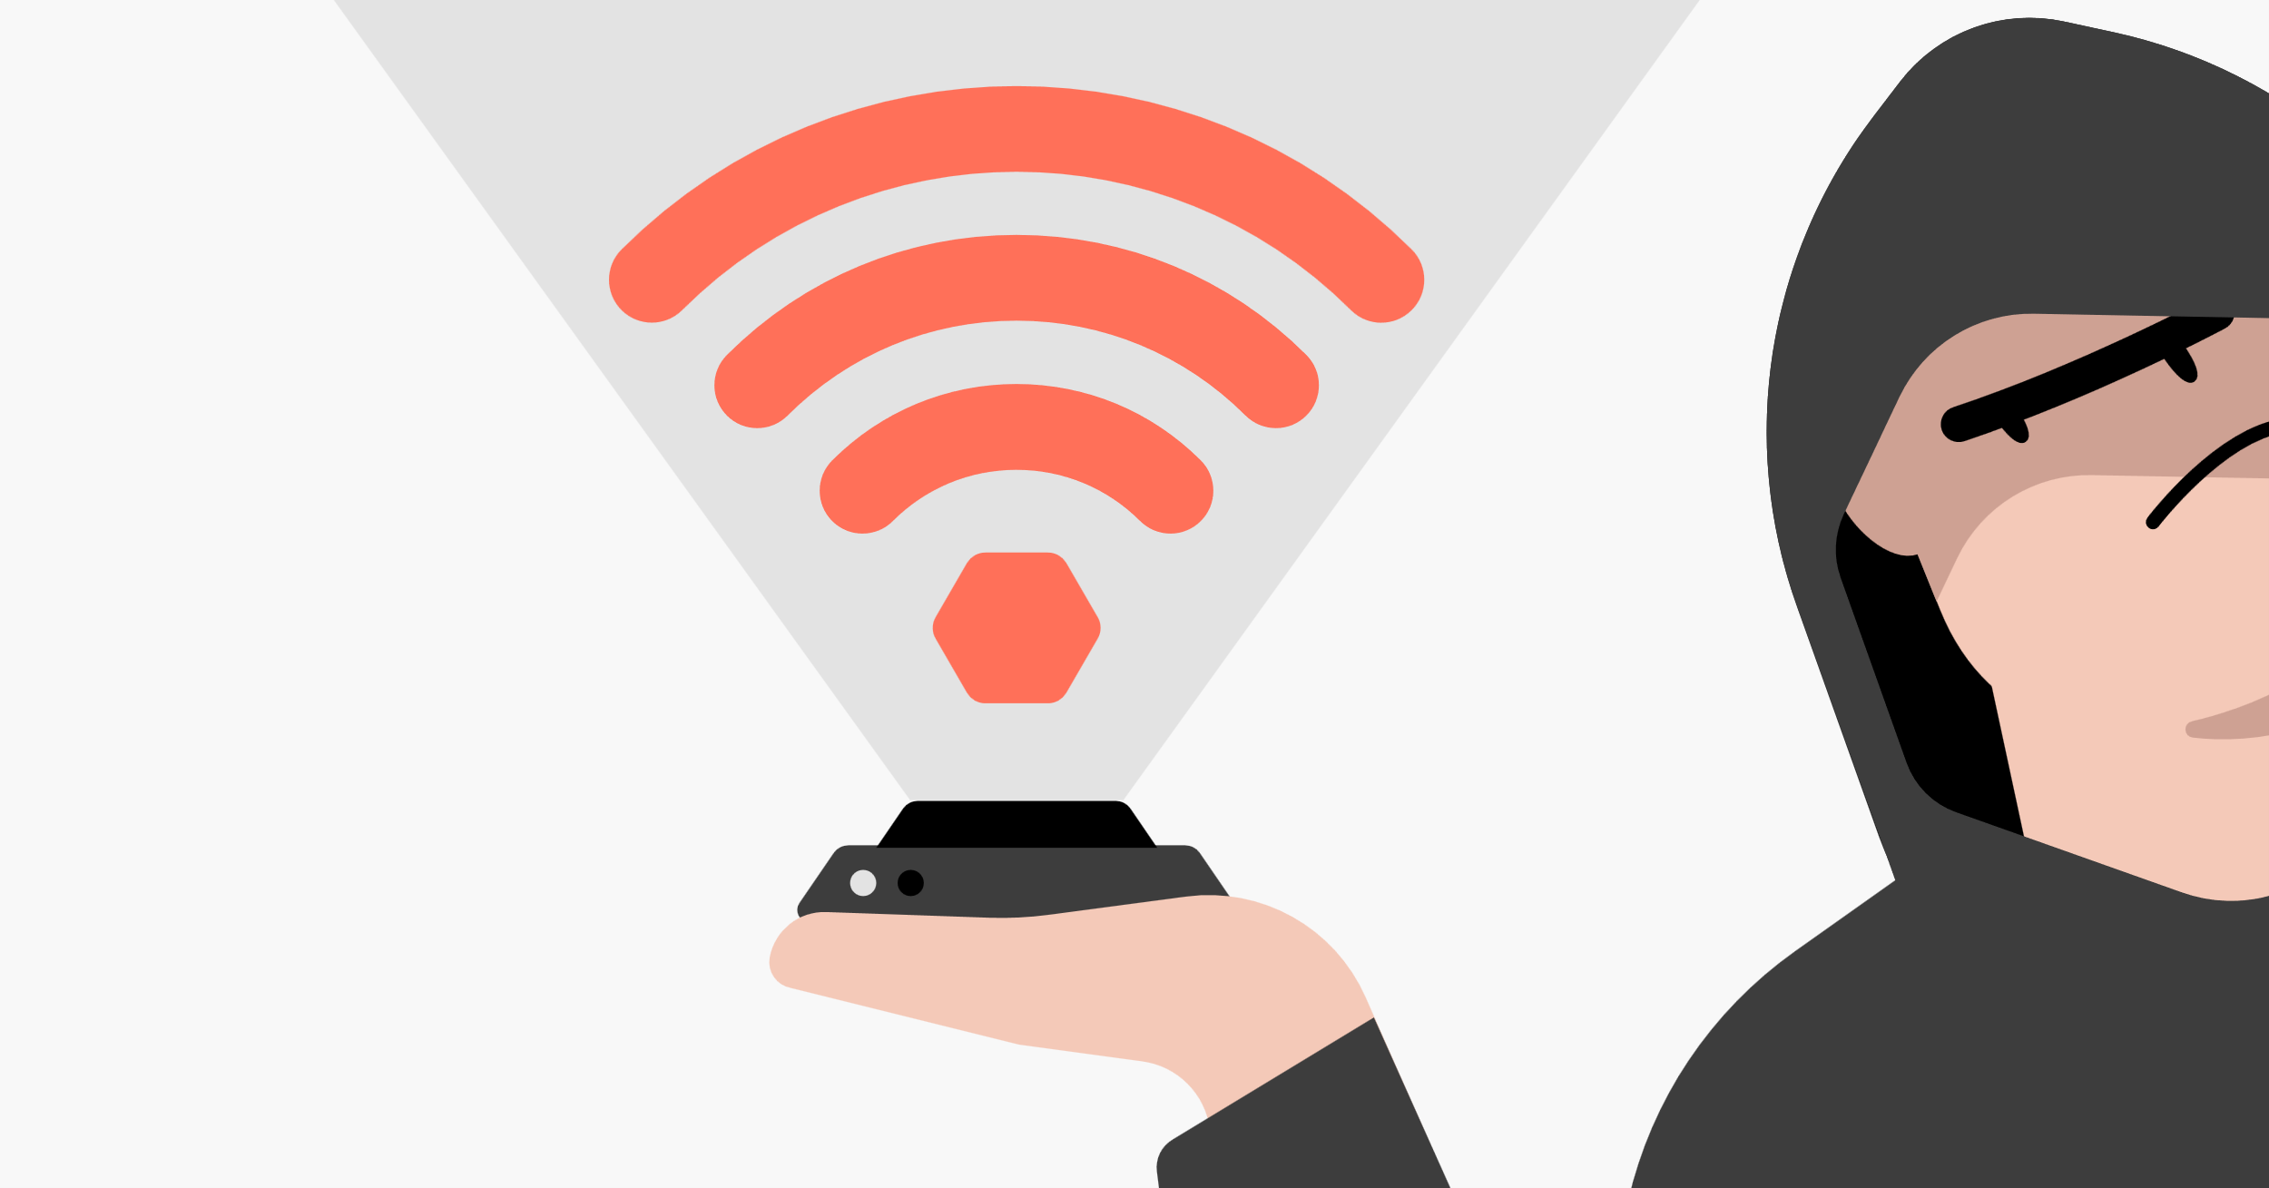
Live Demo Stealing Credentials

Slide 7
Summarizing the steps from attacker’s POV
Started Wi-Fi access point with same SSID from the dedicated Wi-Fi card
Started DNSMASQ to create a small internet structure assigning Ips to the victims
Started the apache server containing the captive portal
Waiting for credentials capture in MySQL database
7

Slide 8
How dangerous it is for organisations?
1. The hacker can now monitor your connection, they can log keystrokes and see your activity as you browse the internet
2. This can allow them to steal login details, view sensitive and confidential organizational information, and potentially further compromise your device.
3. Hackers can inject malware and ransomware that can give them remote access and control of your device even after you’ve logged off.
8

Slide 9
How can it be prevented? Easiest and the most effective ways:
Pay attention to Wi-Fi names: Not all hackers are savvy, and some are lazy enough to set up fake Wi-Fi connections with misspelled words, so look for any obvious errors as a sign of attack.
Listen to any alerts: If your device warns you that a Wi-Fi connection is insecure, you’re better off not connecting to it, even if it looks legitimate.
Use a VPN: VPNs were made to prevent hackers (and anyone) from monitoring your online activity. It’s a good tool to stay private and secure, even if you connect to an evil twin Wi-Fi.
Only browse HTTPS sites: Most browsers offer this by default, as HTTPS connections are encrypted to prevent onlookers from seeing your activity. If your browser notes that a site you’ve visited doesn’t have an HTTPS connection, navigate away from it as soon as possible.
9

Slide 10
Imagine you're at your favorite café, and you see two WiFi networks with the same name. How would you determine which one is safe to use?
10

Slide 11
Thank you for your attention!

